Slide 1
FUTURE IS COMING
Turret Agent
Team DeadlineWarriors
2022/07/14

Slide 2


CONTENTS
01
02
Introduction
Frame
03
04
Challenge
Goal

Slide 3

01
Introduction

Slide 4


Background
Goal
Evil Robots has taken over the world!
Humanity is on its last hope
Protect the base from attacking robots
Destroy all rebellious robotics
End the reign of AI empire
Our Hero
Elite soldier & Engineer
A turret fanatic
Destined to save the world

Slide 5


Upgrades
With enough coins/exp turret can level up and player can choose 1 upgrades from 3 options
Gameplay
Drop turret at strategic position
Fight along or collect upgrades around the map
?
?
?
Players can also collect different weapons
Weapons
Strategize
Turrets
Pistol
Bombs & Traps, etc.
By getting different upgrades, build your turret/weapons according to your playstyle.

Slide 6


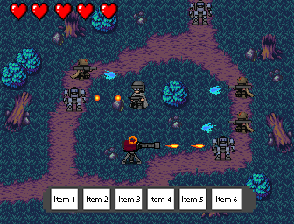
Gameplay sketch
Tower Defense
& RPG
Top-down view
Pixel style

Slide 7
02
Frame

Slide 8

Frame
Scene
Several scences & levels
Attack mode in later scenes
Object
One hero
One or more Turrets
Various weapons
Various enemies
Background
BGM & sound effect
Light Story

Slide 9
03
Challenge

Slide 10

Challenges
Various actions &
Weapons design
Game balancing
Battle mode design

Slide 11
04
Goal

Slide 12
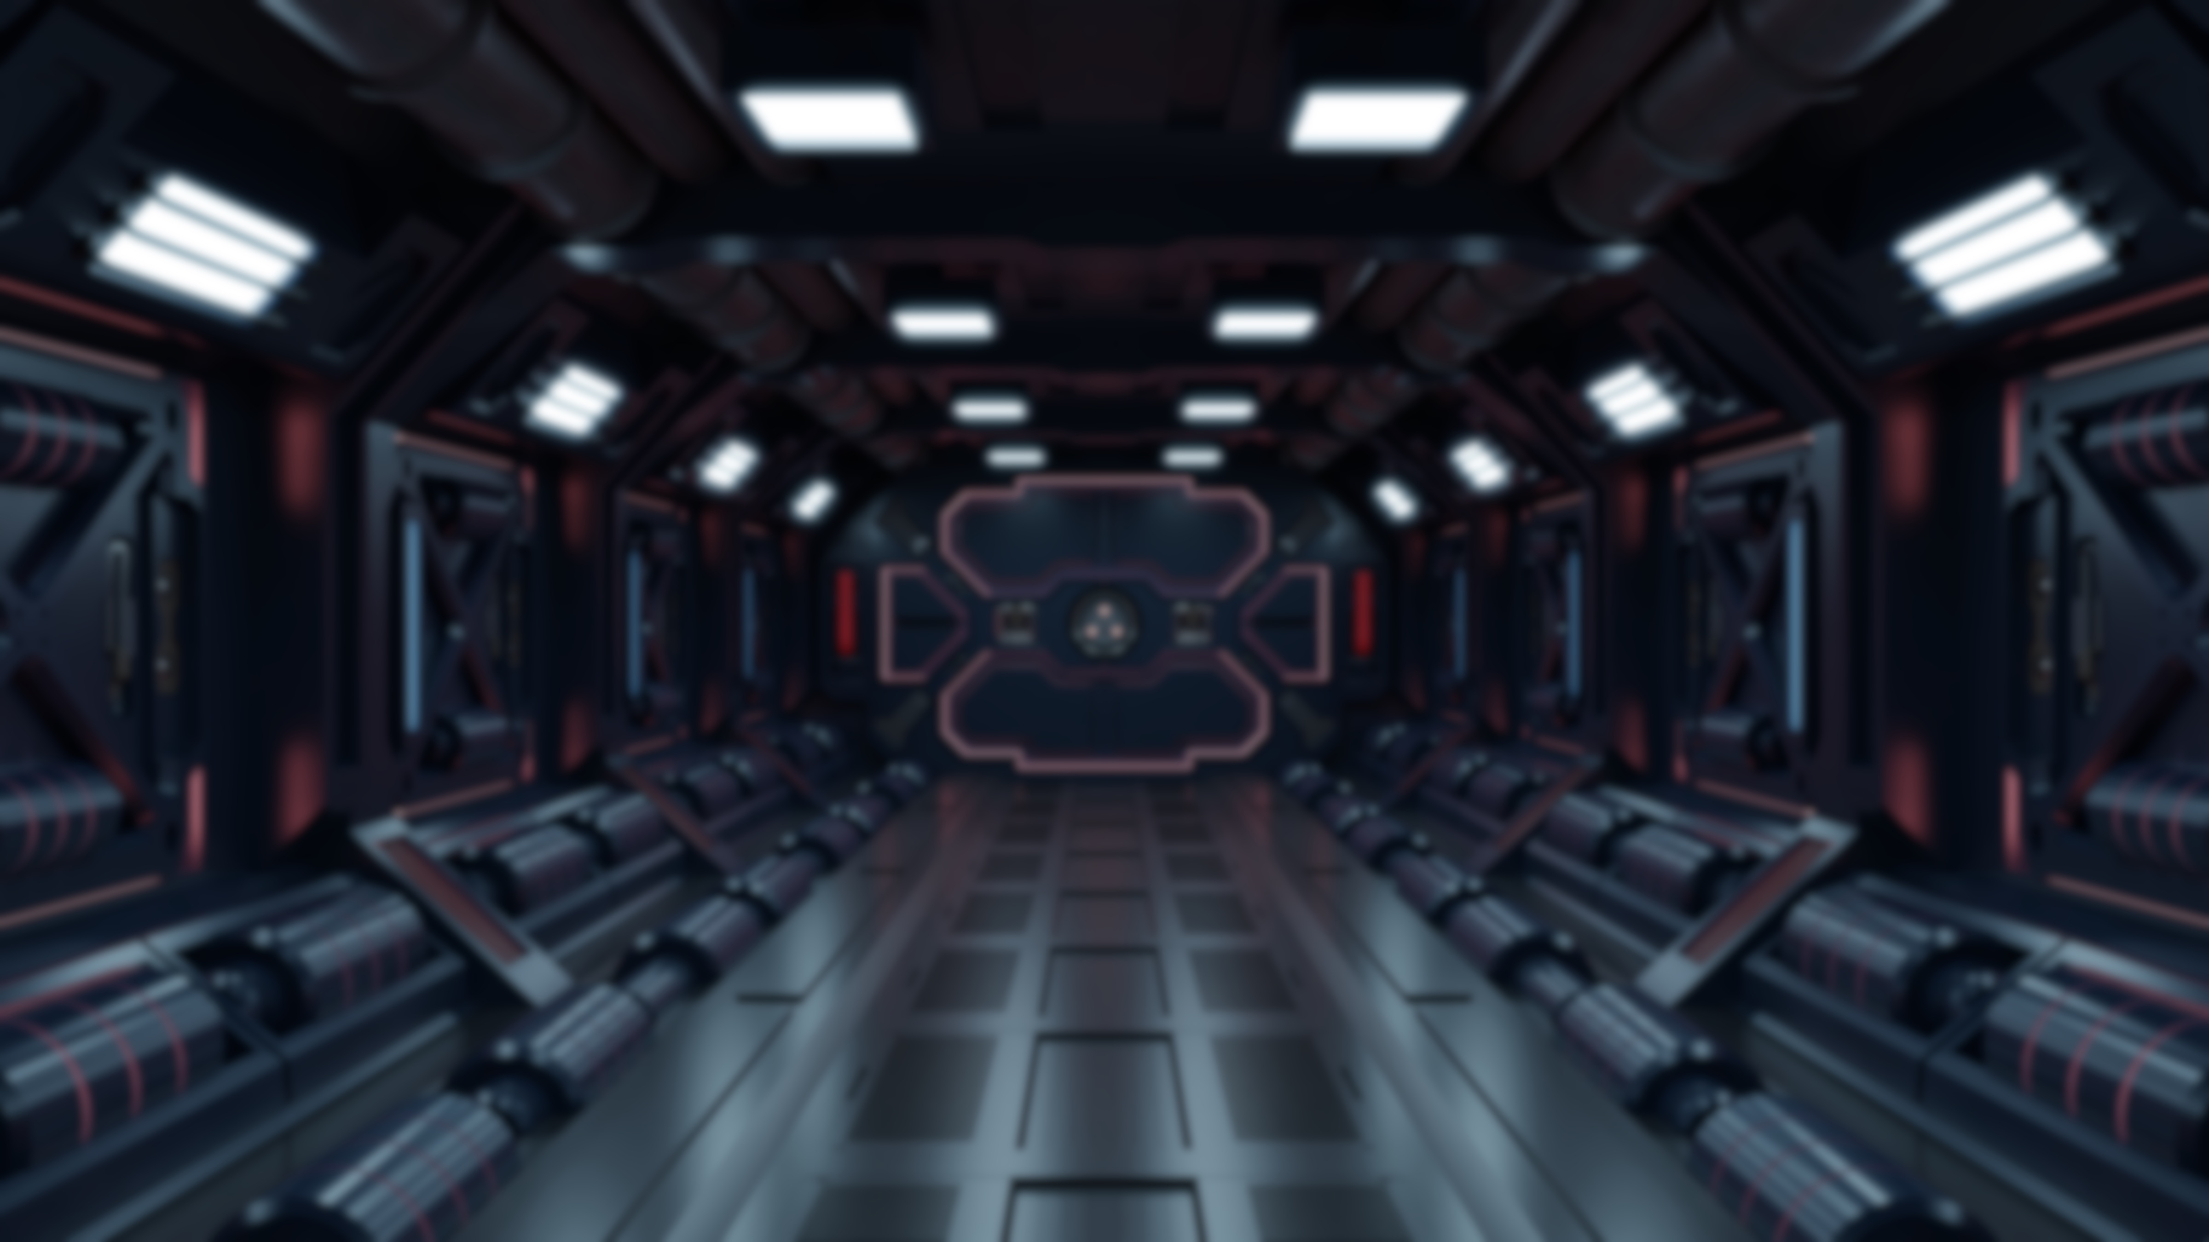

Goal
Bring
Surprises
Refreshing
Gameplay
Do our best!

Slide 13
FUTURE IS COMING
Thank you for your watching!
Team DeadlineWarrior
///DOCER///

